Slide 1
Cyclistic bike-share data analysis
About the company:
In 2016, Cyclistic launched a successful bike-share offering. Since then, the program has grown to a fleet of 5,824 bicycles that are geotracked and locked into a network of 692 stations across Chicago. The bikes can be unlocked from one station and returned to any other station in the system anytime.
Until now, Cyclistic’s marketing strategy relied on building general awareness and appealing to broad consumer segments. One 2 approach that helped make these things possible was the flexibility of its pricing plans: single-ride passes, full-day passes, and annual memberships. Customers who purchase single-ride or full-day passes are referred to as casual riders. Customers who purchase annual memberships are Cyclistic members.
Cyclistic’s finance analysts have concluded that annual members are much more profitable than casual riders. Although the pricing flexibility helps Cyclistic attract more customers, Moreno believes that maximizing the number of annual members will be key to future growth. Rather than creating a marketing campaign that targets all-new customers, Moreno believes there is a very good chance to convert casual riders into members. She notes that casual riders are already aware of the Cyclistic program and have chosen Cyclistic for their mobility needs.
Moreno has set a clear goal: Design marketing strategies aimed at converting casual riders into annual members. In order to do that, however, the marketing analyst team needs to better understand how annual members and casual riders differ, why casual riders would buy a membership, and how digital media could affect their marketing tactics. Moreno and her team are interested in analyzing the Cyclistic historical bike trip data to identify trends.

Slide 2
Question to answer:
How do annual members and casual riders use Cyclistic bikes differently?
Goal:
Converting casual riders into annual members
Data source:
The data has been made available by Motivate International Inc. and downloaded from
https://divvy-tripdata.s3.amazonaws.com/index.html
The chosen data range is January – December 2023. Each month data is stored in a separate zip folder containing relevant CSV files.
About the data :
Reliable - it is a complete internal showing of all bike users. That excludes sample selection bias
Orginal – direct access to the original data source of e Cyclistic’s historical trip data
Comprehensive – showing enough information to answer the question
Current – data comes from 2023 and is relevant
Cited – known reliable location and ownership

Slide 3
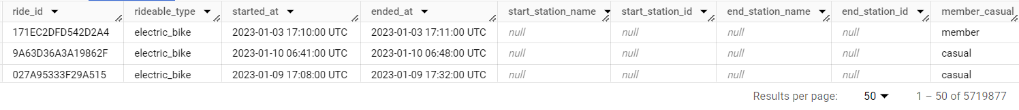
Joining separate data tables into a single one:
SELECT*
FROM `project-1-asia.Rides.Jan`
UNION ALL
SELECT*
FROM `project-1-asia.Rides.Feb`
UNION ALL
SELECT*
FROM `project-1-asia.Rides.March`
UNION ALL
SELECT*
FROM `project-1-asia.Rides.April`
UNION ALL
SELECT*
FROM `project-1-asia.Rides.May`
UNION ALL
SELECT*
FROM `project-1-asia.Rides.June`
UNION ALL
SELECT*
FROM `project-1-asia.Rides.July`
UNION ALL
SELECT*
FROM `project-1-asia.Rides.Aug`
UNION ALL
SELECT*
FROM `project-1-asia.Rides.Sep`
UNION ALL
SELECT*
FROM `project-1-asia.Rides.Oct`
UNION ALL
SELECT*
FROM `project-1-asia.Rides.Nov`
UNION ALL
SELECT*
FROM `project-1-asia.Rides.Dec`
The data has 5,719,877 rows. Due to the high volume of data, and the need for aggregation and handling ease, SQL was used to check for potential issues and to pull summarized information.
Table columns and data overview:
SELECT*
FROM `project-1-asia.Rides.a_Full_Year`

Slide 4
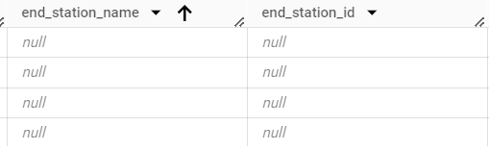
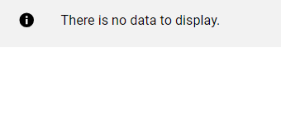
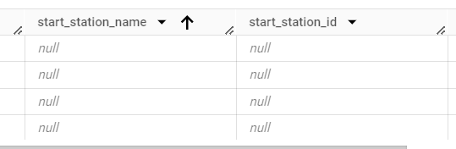
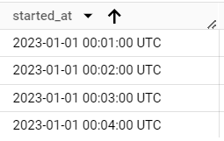
Checking for NULL and 0 using query
SELECT *
FROM `project-1-asia.Rides.Full_Year_sorted`
WHERE ride_id = '0' OR ride_id IS NULL
Ascending and descending sorting to show issues:

Slide 5


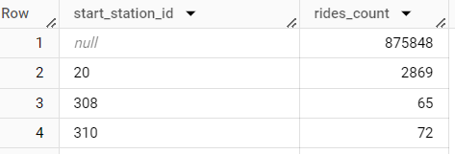
Exploring data: Checking counts of stations and rides per start station (3rd column):
SELECT COUNT (start_station_id) as start_stations_count FROM `project-1-asia.Rides.a_Full_Year` | SELECT COUNT (end_station_id) as end_stations_count FROM `project-1-asia.Rides.a_Full_Year` | SELECT start_station_id, COUNT (ride_id) as rides_count, FROM `project-1-asia.Rides.a_Full_Year` GROUP BY start_station_id
Result: | Result: | Result:
Since start/end station IDs and names have a significant nubmer of missing (null) values, are not crucial to analysis and can’t be provided by Cyclistic, they will be not included in analysis

Slide 6
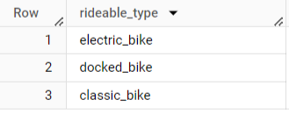

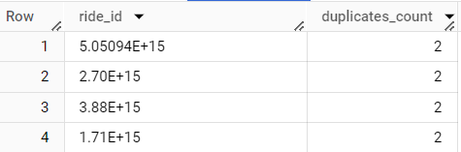
Checking for duplicates:
SELECT DISTINCT(rideable_type) FROM `project-1-asia.Rides.a_Full_Year` | SELECT DISTINCT(member_casual) FROM `project-1-asia.Rides.a_Full_Year` | SELECT ride_id, COUNT (ride_id) as duplicates_count FROM `project-1-asia.Rides.a_Full_Year` GROUP BY ride_id HAVING COUNT (ride_id)>1
Result: no duplicates | Result: no duplicates | Result: duplicates found

Slide 7
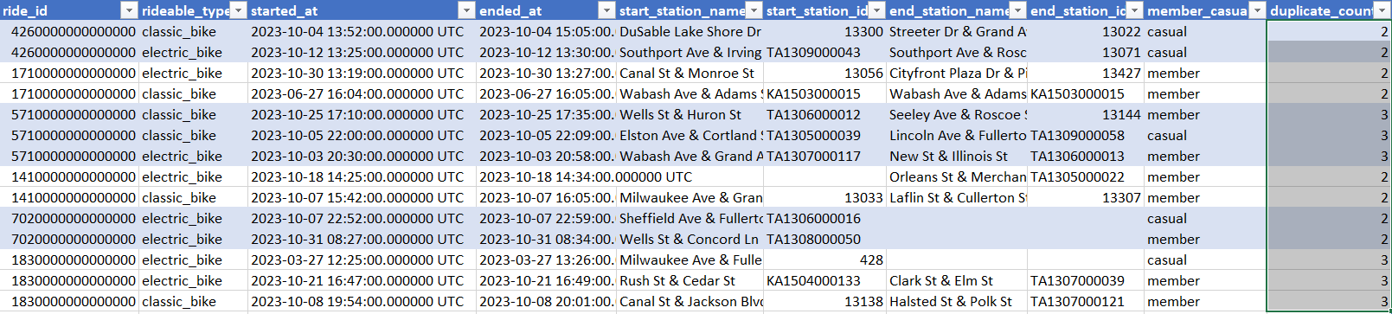
Further investigation of duplicates in the ride_id column :
WITH duplicates as (SELECT
*,
COUNT(ride_id) OVER (PARTITION BY ride_id) AS duplicate_count
FROM
`project-1-asia.Rides.a_Full_Year`)
SELECT*
FROM duplicates
WHERE duplicate_count >1
Result:
Although IDs are duplicated, the rest of data related to them is unique - * verified using conditional formatting, duplicates option in the started_at column

Slide 8

Ride durations statistics
SELECT member_casual, AVG (TIMESTAMP_DIFF(ended_at, started_at, HOUR)) as Avg_Ride_duration, SUM (TIMESTAMP_DIFF(ended_at, started_at, HOUR)) as SUM_Ride_duration, MIN (TIMESTAMP_DIFF(ended_at, started_at, HOUR)) as MIN_Ride_duration, MAX (TIMESTAMP_DIFF(ended_at, started_at, HOUR)) as MAX_Ride_duration, FROM `project-1-asia.Rides.a_Full_Year` GROUP BY member_casual Result: Some ride durations are below or 0 – which is incorrect

Slide 9
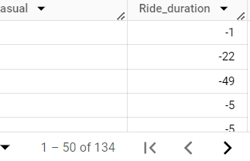
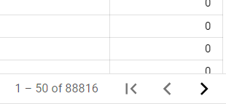

Query exploring the numer of rides below and equal to 0: WITH Ride_duration_table AS ( SELECT ride_id, rideable_type, started_at, ended_at,member_casual, TIMESTAMP_DIFF(ended_at, started_at, MINUTE) as Ride_duration FROM `project-1-asia.Rides.a_Full_Year` ) SELECT ride_id, rideable_type, started_at, ended_at,member_casual, Ride_duration FROM Ride_duration_table WHERE Ride_duration <0 The above query with a changed WHERE clause: WHERE Ride_duration =0 Result: 134 rows show < 0 ride duration 88816 rows of ride durations are = 0 They can be filtered out as it’s not a significant percentage of the total data of Ride_durations

Slide 10
New table with new columns and information filtered out:
Ride_duration > 0 only
Stations’ names and IDs columns are dropped
Month and day of week extracted from the date
WITH Ride_duration_table AS (
SELECT
ride_id, rideable_type, started_at, ended_at,member_casual,
TIMESTAMP_DIFF(ended_at, started_at, MINUTE) as Ride_duration
FROM `project-1-asia.Rides.a_Full_Year`
)
SELECT
ride_id, rideable_type, started_at, ended_at,member_casual, Ride_duration,
EXTRACT(MONTH from started_at) as MONTH_start,
EXTRACT(MONTH from ended_at) as MONTH_end,
FORMAT_DATE('%A', started_at) as day_of_week
FROM Ride_duration_table
WHERE Ride_duration >0

Slide 11
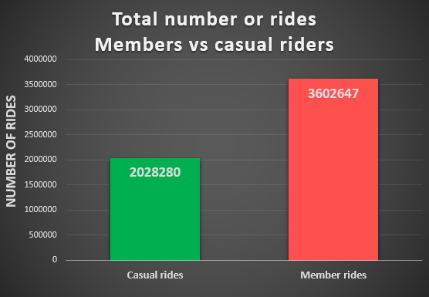

Excel chart:
SELECT member_casual, COUNT (member_casual) as user_count FROM `project-1-asia.Rides.Full_Year_sorted` GROUP BY member_casual Result:
62.98%
35.46%

Slide 12
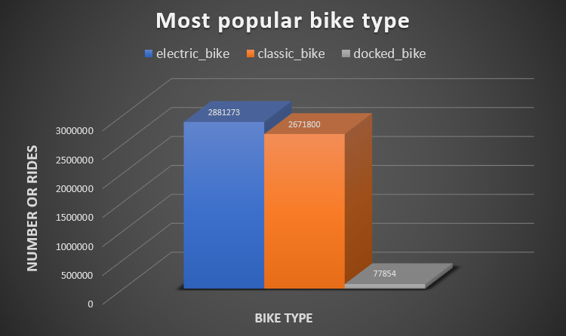
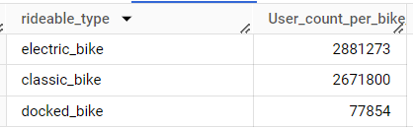
Excel chart:
SELECT rideable_type, COUNT(member_casual) as User_count_per_bike_type FROM `project-1-asia.Rides.Full_Year_sorted` GROUP BY rideable_type Result:
51.17%
47.45%
1.38%

Slide 13
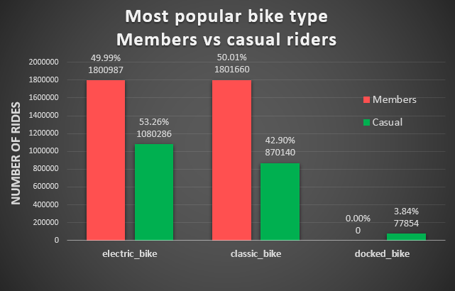
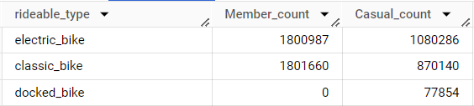
Excel chart:
SELECT rideable_type, COUNTIF(member_casual = 'member') as Member_count, COUNTIF(member_casual = 'casual') as Casual_count FROM `project-1-asia.Rides.Full_Year_sorted` GROUP BY rideable_type; Result:

Slide 14
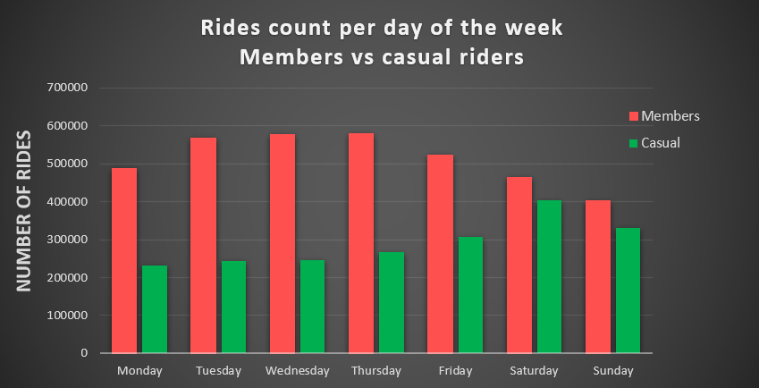
Excel chart:
SELECT day_of_week, COUNTIF(member_casual = 'member') as Member_count, COUNTIF(member_casual = 'casual') as Casual_count FROM `project-1-asia.Rides.Full_Year_sorted` GROUP BY day_of_week ORDER BY CASE day_of_week WHEN 'Monday' THEN 1 WHEN 'Tuesday' THEN 2 WHEN 'Wednesday' THEN 3 WHEN 'Thursday' THEN 4 WHEN 'Friday' THEN 5 WHEN 'Saturday' THEN 6 WHEN 'Sunday' THEN 7 ELSE 999 -- Handle potential unexpected values END;
Weekdays are more popular amongst members and weekend amongst casual riders

Slide 15
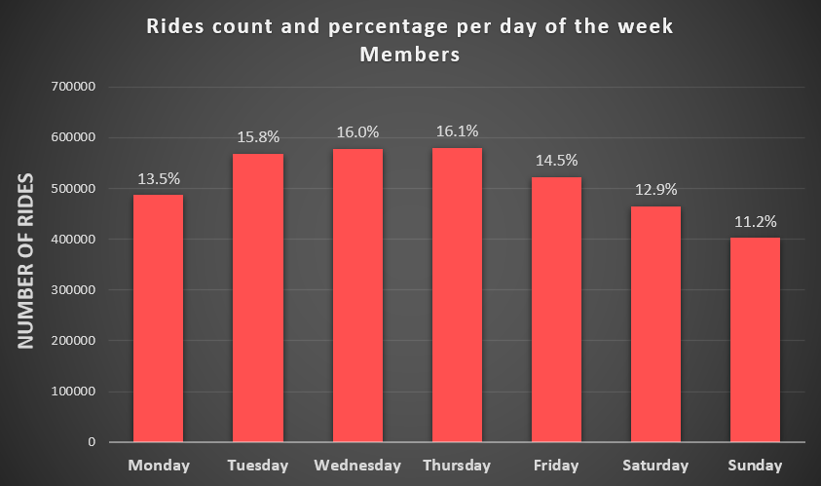
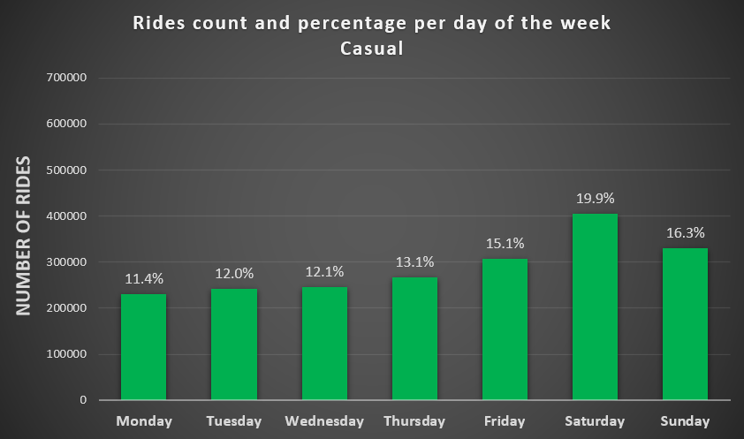
Previous chart split into Members and Casual riders, and showing percentages comparison

Slide 16
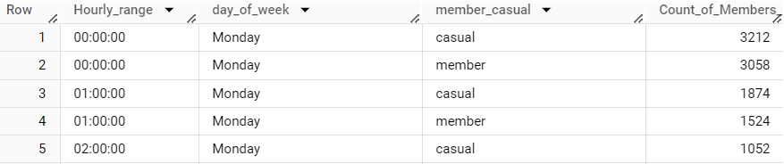
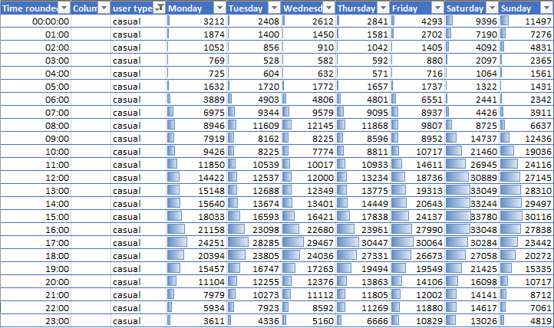
Hourly use per day of the week
WITH truncated as( SELECT started_at,member_casual,day_of_week, DATE_TRUNC(started_at, HOUR) AS truncated_hour FROM `project-1-asia.Rides.Full_Year_sorted` ) SELECT EXTRACT(TIME FROM truncated_hour) AS Hourly_range, day_of_week,member_casual, COUNT(*) AS Count_of_Members_Casual FROM truncated GROUP BY day_of_week, Hourly_range, member_casual ORDER BY CASE day_of_week WHEN 'Monday' THEN 1 WHEN 'Tuesday' THEN 2 WHEN 'Wednesday' THEN 3 WHEN 'Thursday' THEN 4 WHEN 'Friday' THEN 5 WHEN 'Saturday' THEN 6 WHEN 'Sunday' THEN 7 ELSE 999 END, Hourly_range, member_casual
Excel table

Slide 17
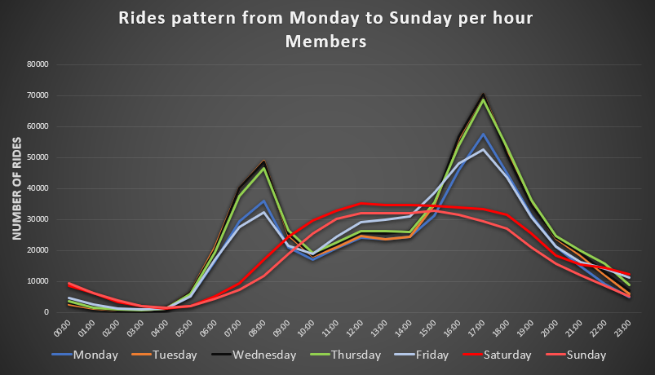
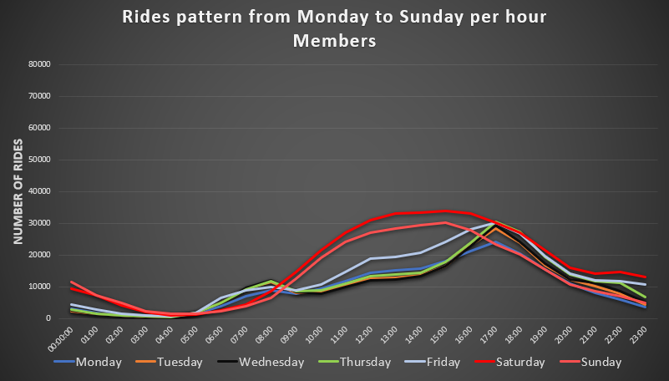
Both casual riders and members use bikes differently on weekdays than on the weekends.
Members use bikes for work hence different use patterns during weekdays between members and casual riders.

Slide 18
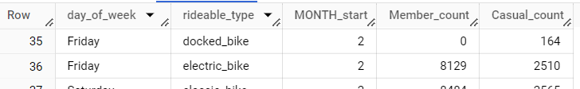
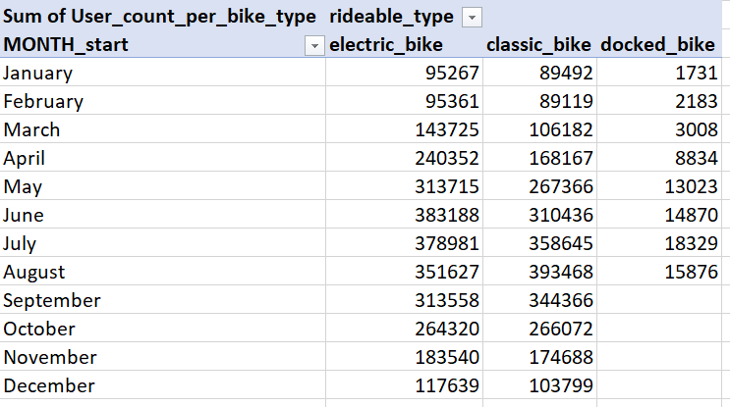
Bike type popularity data
SELECT day_of_week, rideable_type,MONTH_start, COUNTIF(member_casual = 'member') as Member_count, COUNTIF(member_casual = 'casual') as Casual_count FROM `project-1-asia.Rides.Full_Year_sorted` GROUP BY day_of_week, rideable_type, MONTH_start ORDER BY MONTH_start, -- Order by month ascending CASE day_of_week WHEN 'Monday' THEN 1 WHEN 'Tuesday' THEN 2 WHEN 'Wednesday' THEN 3 WHEN 'Thursday' THEN 4 WHEN 'Friday' THEN 5 WHEN 'Saturday' THEN 6 WHEN 'Sunday' THEN 7 ELSE 999 -- Handle potential unexpected values END, rideable_type; -- Order by rideable_type
Excel pivot table

Slide 19
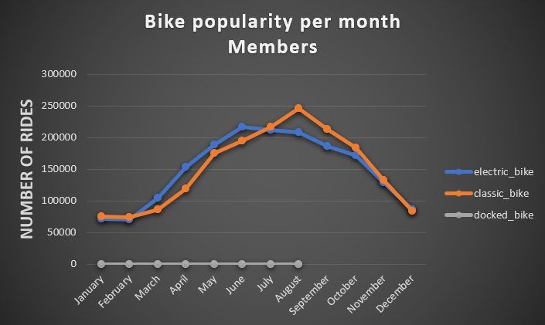
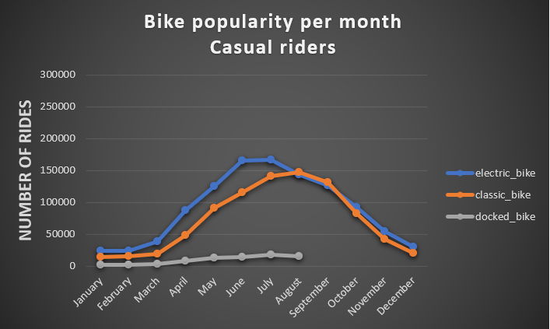
Excel chart (docked bike has no data for the last quarter possibly discontinued)

Slide 20
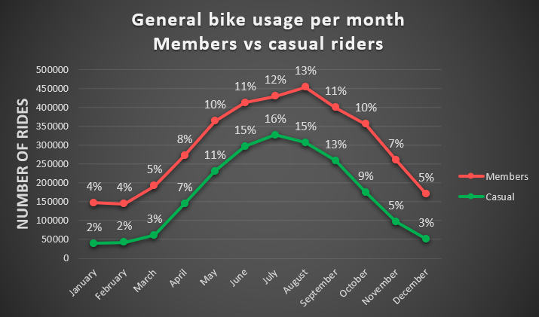
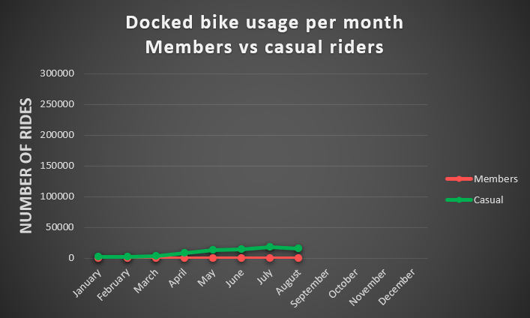
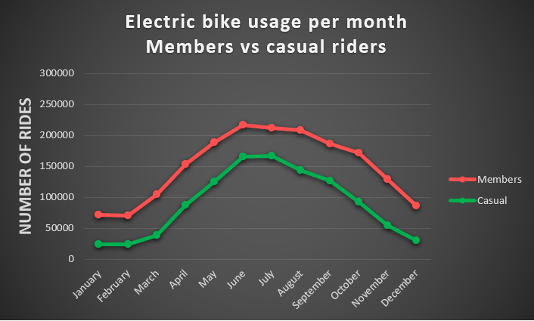


Slide 21
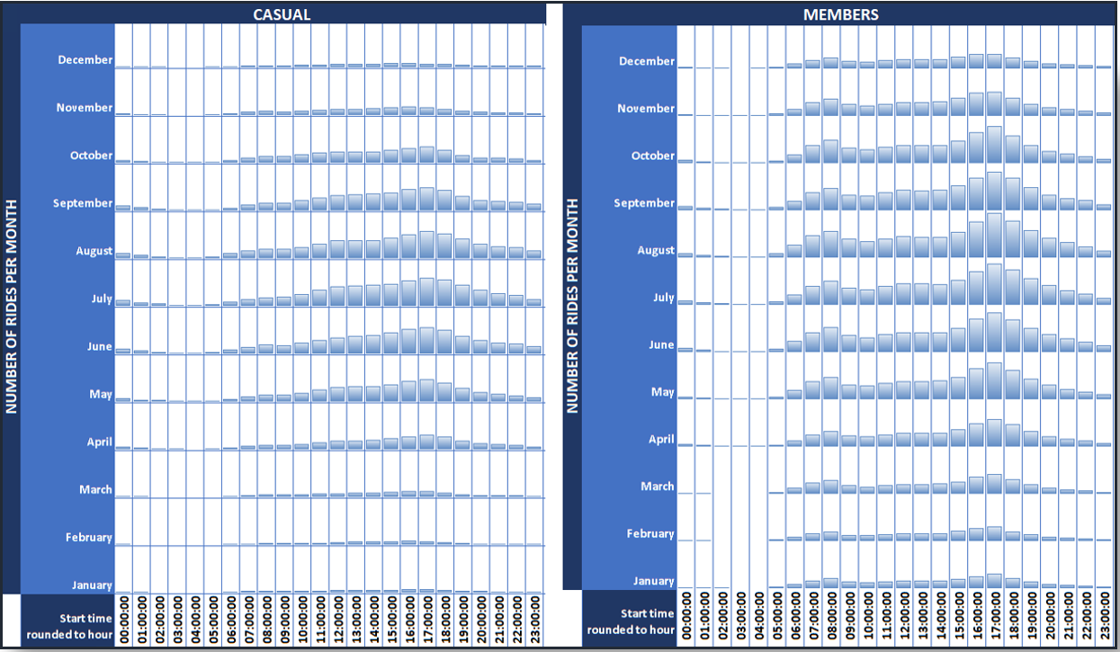
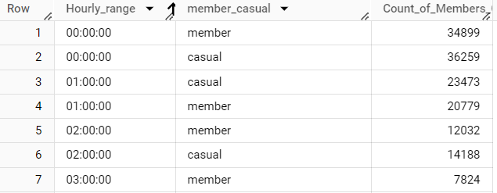
Most common ride times
WITH truncated as( SELECT started_at,member_casual, DATE_TRUNC(started_at, HOUR) AS truncated_hour FROM `project-1-asia.Rides.Full_Year_sorted` ) SELECT EXTRACT(TIME FROM truncated_hour) AS Hourly_range, member_casual, COUNT(*) AS Count_of_Members_Casual FROM truncated GROUP BY Hourly_range, member_casual;
Excel table with conditional formatting data bars for an overview

Slide 22
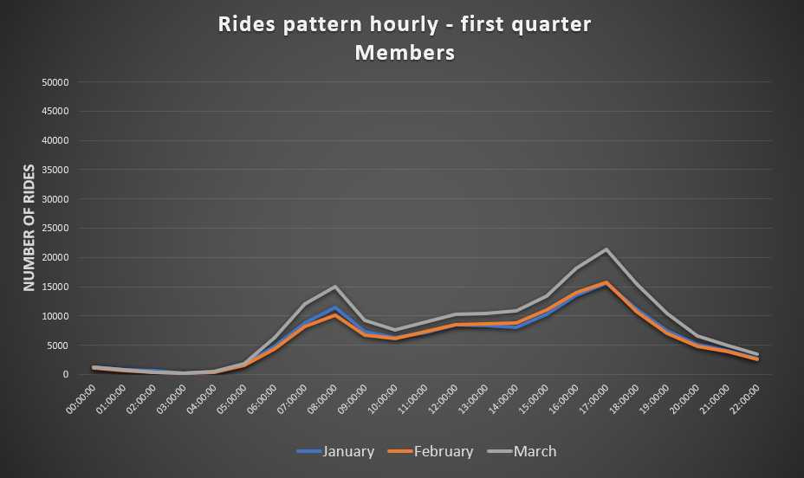
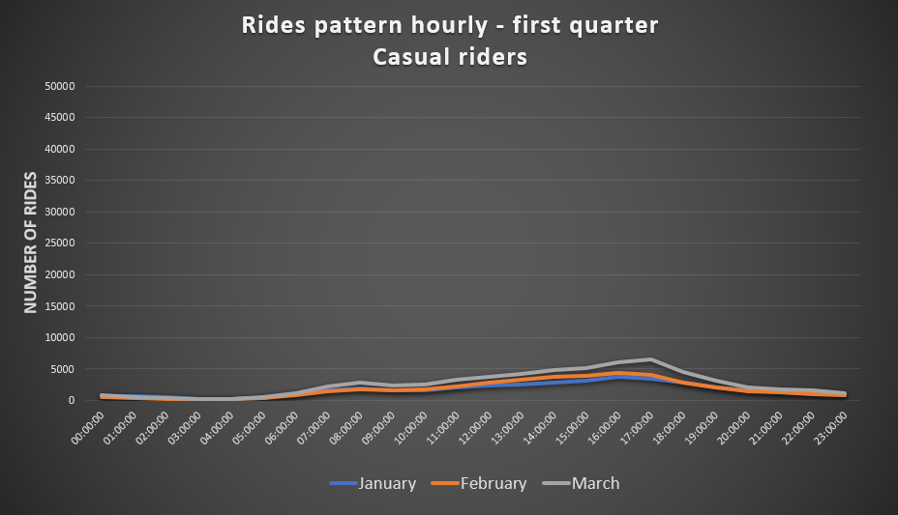
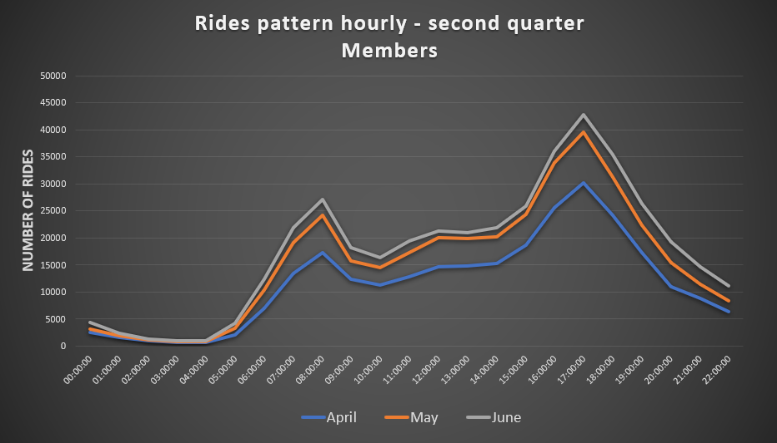
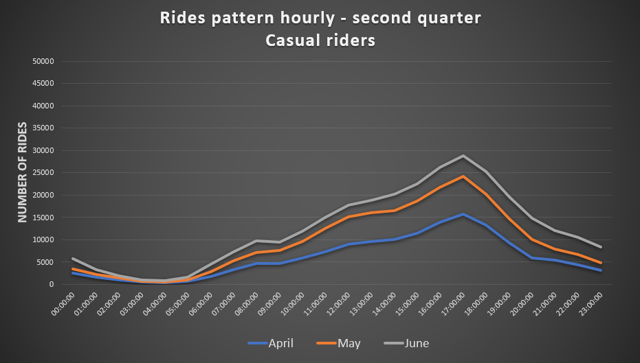

Slide 23
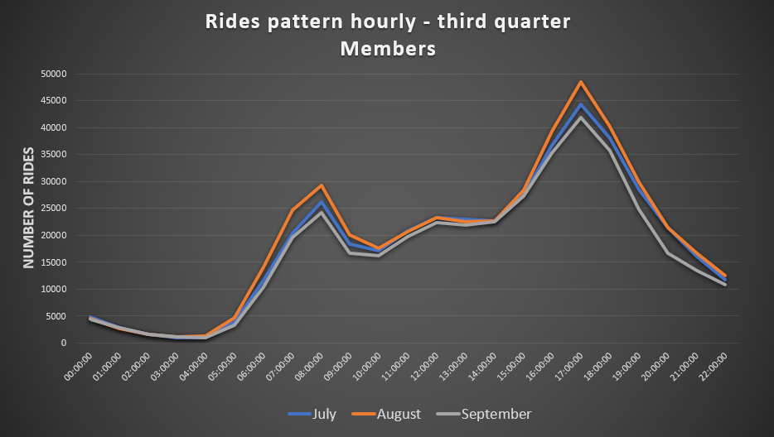
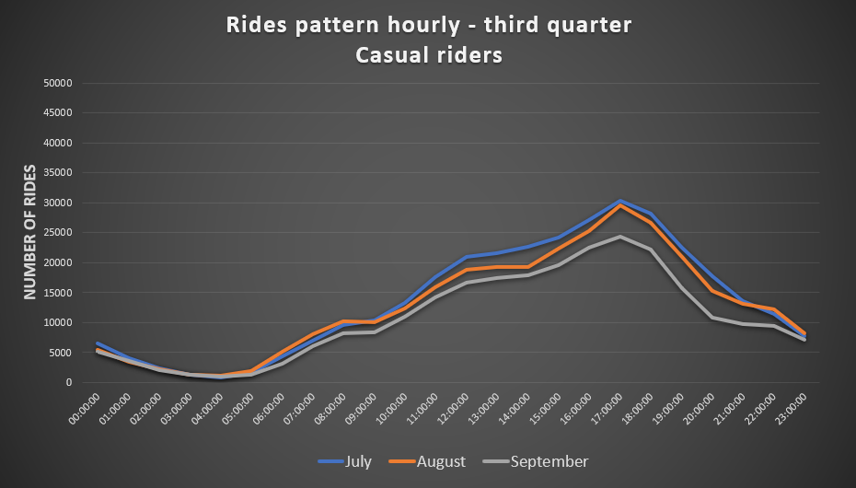
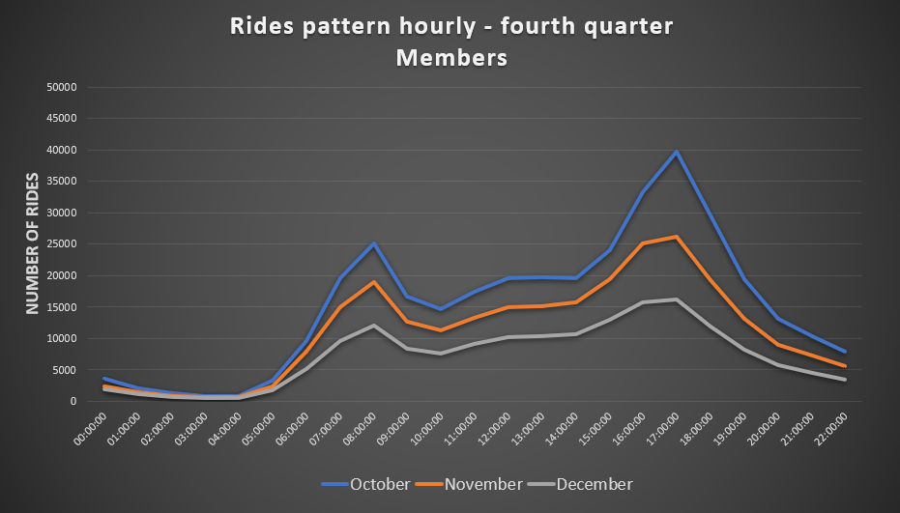
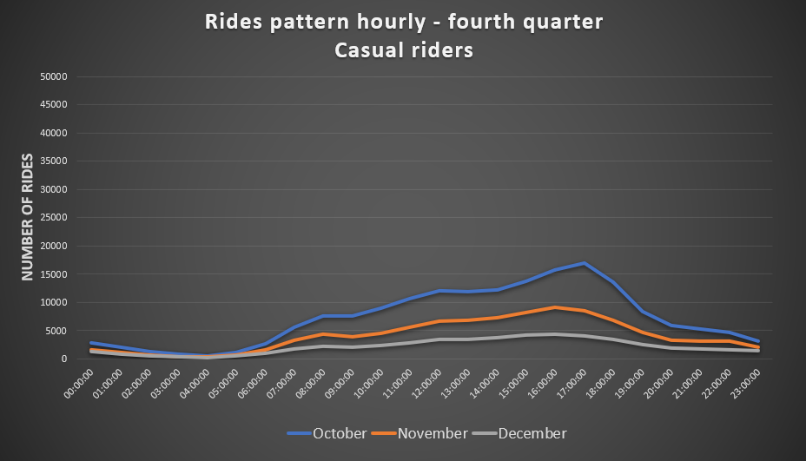

Slide 24
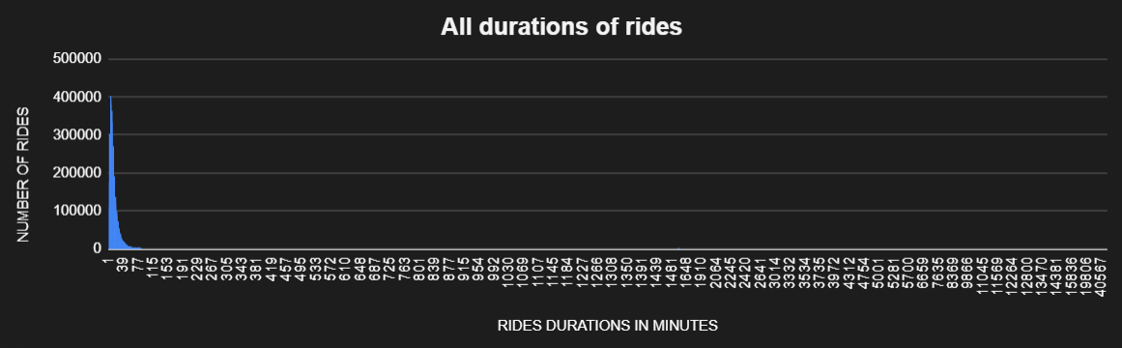
Most popular ride durations
SELECT ride_duration,
FROM `project-1-asia.Rides.Full_Year_sorted`
Data exploration from BigQuery directly in Google Sheets

Slide 25


Number of rides longer than 26 hours
Number of rides longer than 26 hours: WITH Count_long_rides as (SELECT ride_duration, member_casual, COUNT(Ride_duration) as number_of_rides FROM `project-1-asia.Rides.Full_Year_sorted` WHERE ride_duration>1560 GROUP BY Ride_duration, member_casual ORDER BY ride_duration ASC, member_casual ASC ) SELECT member_casual, COUNT(number_of_rides) as Number_of_rides_over26h FROM Count_long_rides GROUP BY member_casual
There are 1091 very long-duration rides, which is uncommon for a bike share. All of these are only casual rides. The data suggest that users keep bikes for days or even weeks. It would have to be investigated further why there are such long-duration rides in the data set. Since the number of these is only a small percentage out of 5mln row data filtering them out will not cause a significant data loss.

Slide 26
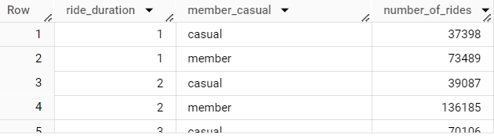
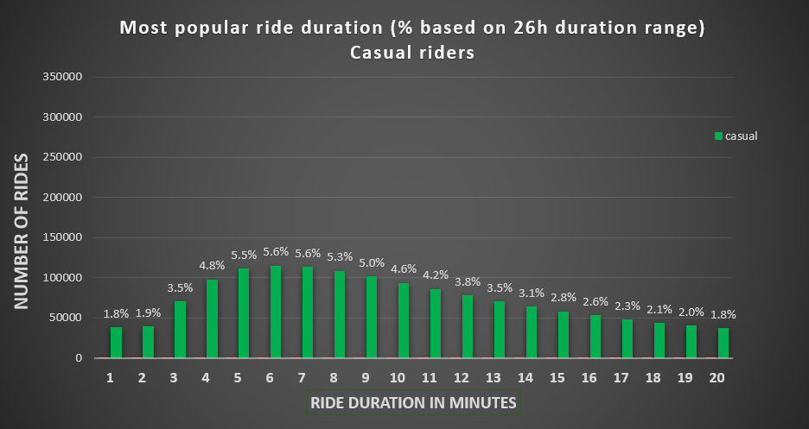
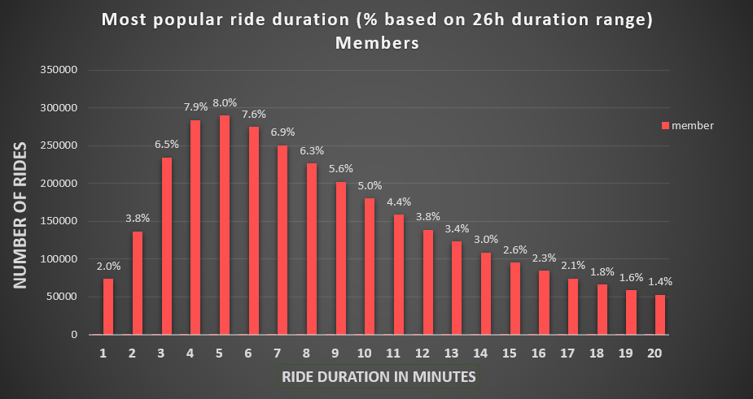
More detailed visualisation of most common ride durations, Excel chart
SELECT ride_duration, member_casual, COUNT(Ride_duration) as number_of_rides FROM `project-1-asia.Rides.Full_Year_sorted` GROUP BY Ride_duration, member_casual ORDER BY ride_duration ASC, member_casual ASC Excel calculation of % based on up to 26h duration of rides.

Slide 27
Conclusions:
Rider Demographics:
Casual riders constitute 35% of all rides.
They prefer electric bikes (53%) over classic ones (43%), while docked bikes have low usage (4%).
Members use electric and classic bikes equally but rarely opt for docked bikes.
Usage Patterns:
Casual riders prefer weekends, with the peak day being Saturday.
Members predominantly use bikes during weekdays, peaking from Tuesday to Thursday. Saturday also sees significant usage.
Seasonal Trends:
Both casual and member bike usage increases during the summer.
Casual riders show a faster increase in summer ride count compared to members.
Classic bike usage by members peaks from May to August, while casual riders shift to classic bikes after docked bikes end in August.
Monthly Peaks:
Classic bike usage peaks for both user types in July.
Members' peak usage falls in August.
Daily Commute Trends:
Members use bikes for commuting at 8:00 and 17:00 and around lunchtime (12:00).
A portion of casual riders also exhibit similar behavior. Casual riders' overall ride count increases steadily until 17:00.
Both user types use bikes around midnight in the summer.
Common Ride Durations and times:
The most common ride durations for members are 3-10 minutes (54% of rides), peaking at 4-6 minutes.
The range of similar duration times is wider for casual users:
Casual riders prefer 3-14 minute rides (54% of rides), with a peak from 5-8 minutes.
Weekend hourly usage patterns are similar for both, with members starting rides earlier. Peak times are 11:00-17:00.

Slide 28
Ride Duration Anomalies:
Rides with durations below zero or exceeding 26 hours represent under 2% of all rides.
The reason behind these anomalies needs further investigation.
Station ID/Name Data Missing:
There is missing station ID/name data that requires exploration to understand the root cause.
Summary:
Members use bikes to commute to work and around lunchtime and therefore use them more during weekdays than on weekends. Favourite duration ride range is more narrow than casual riders’.
Casual riders prefer weekends and summer, in general, the usage during the day increases steadily towards around 17:00. Electric bikes are preferred slightly over classic bikes.
Three top recommendations:
Offer a limited-time free trial membership for casual riders, allowing them to experience the benefits of membership without an immediate commitment.
Introduce weekend memberships, designed for rides exclusively on weekends (Friday – Sunday) throughout the year, and offer quarterly memberships with reduced pricing during low-usage months.
Launch an advertising campaign showcasing scenic and nature destinations accessible by bikes, along with guidance on biking to a location and returning via public transport.

